Slide 1
Best Financial Practices for Worshipping Communities
Presented By
Linda Riley Mitchell, CPA – Chief Financial Officer
The Rev. Canon Joann Saylors – Mission Amplification
Susan Aldana – Assistant Controller

Slide 2
Essential Topics in Parish Finance
For I know the plans I have for you Declares the Lord, plans to prosper you and not to harm you, plans to give you hope and a future
-Jeremiah 29:11
Welcome and Introductions
Internal Controls
Annual Audits
Budgeting
Q&A
Resources

Slide 3
Internal Controls: Best Practices
Segregation of duties
Levels for Authorizations
Written Policies and Procedures
Recordkeeping
Monitoring

Slide 4
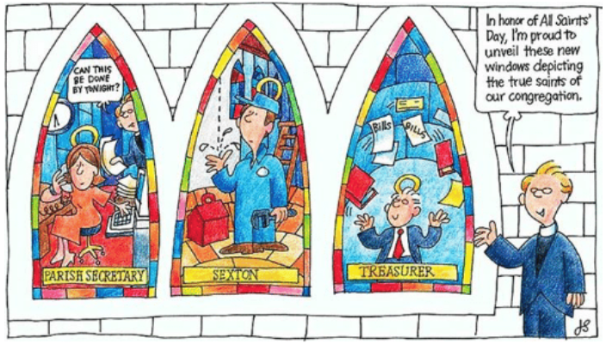
Separation of Functions: Positions

Slide 5
Financial Role of Vestry
Assure adequate Financial Controls
Appoint Key Finance Positions
Assign responsibility for the Stewardship of programs, ministries, facilities, and property of the church
Appoint the Finance Committee
Establish and approve annual Revenue Forecast
Annual Stewardship Campaign
Direct development of, and approve annual Budget (and any changes thereto)
Appoint the Annual Audit Committee

Slide 6

Assuring adequate financial controls reduces risk of Fraud
Fraud can be perpetrated by:
  Outright theft
  Not recording transactions in the books
  Falsely recording transactions in the books
  Lack of control of the offering receipts

Slide 7
Internal Controls
Key points to remember when setting or reviewing your controls:
Internal controls will aid in the creation of an audit trail
Segregation of Duties
  No one person should handle all aspects of a single transaction. The responsibility for authorization, accounting for and custody of the related asses must be separated.
A transaction involves 5 steps: Request, Approval, Authorization, Execution and Recording
  Signers – Individuals authorized by the Vestry to conduct banking transactions on behalf of the church.
Authority levels are defined by Vestry
  Remember: Control systems only work if authority and responsibility levels are defined and this structure of responsibility is known within the organization.

Slide 8

Internal Controls – Recap
Why is it important to have Internal Controls?
What are Internal Controls designed to prevent or identify:

Slide 9

Annual Audits
Annual Audits
  Provides Objective Insight
  Improves Efficiency of Operations
  Evaluates Risks and Protects Assets
  Assesses Controls
  Ensures Compliance with Laws and Regulations

Slide 10
Annual Audits
“The accounts of all Parishes, Missions, and other
Church institutions… shall be audited annually.”
Canon 4 – Section 4.5
The canon also states that:
“The reports of all such audits, including any memoranda issued by the auditing authority regarding internal controls or other accounting matters, shall be filed with the Bishop not later than thirty (30) days following the date of such reports but in any event prior to September 1 of each year covering the financial reports…”

Slide 11
More churches are completing audits

Slide 12
Church Audit Compliance Overview
Of the 121 audit reports received:
  82 were prepared by a committee of the church.
  35 were external audits performed by a CPA firm.
  4 were compilations prepared by an accounting firm or bookkeeper.
The reports varied widely as to content and detail.
  88 included some financial statements.
  28 were signed audit letters with little detail and no financial statements.
  88 included some financial statements.
  3 were compilations with no financial statements.
  Many noted control weaknesses and made recommendations.

Slide 13
Budget
Purpose of a Budget:
  To serve as a robust tool for financial transparency, making clear current or aspirational alignment with congregation’ stated vision and mission
    Mission – who your congregation is and what God is calling you to do
    Vision – hopeful picture of the future that describes the impact of what you do
  Above all, a budget is a communication tool

Slide 14
Line item budget
Revenue:
  Pledges
  Sunday donations (plate)
  Other gifts
  Rental fees
  Fundraisers
  Investments
  Other income

Slide 15
Line item budget
Expenses:
  Salaries & benefits
  Bills
  Program costs
  Mission & outreach expenses
  Diocesan assessment
  Other expenses

Slide 16
Budget
Developing line-item budget:
  Most basic – begin with prior year actual revenue and expenses and adjust for changes
    Staff changes
    Compensation changes
    Pledge adjustments
    Fundraiser expectations
    Increased costs
    Changes to equipment leases
    Etc.

Slide 17
Budget
Purpose of a budget:
  To serve as a robust tool for financial transparency, making clear current or aspirational alignment with congregation’ stated vision and mission
    Mission – who your congregation is and what God is calling you to do
    Vision – hopeful picture of the future that describes the impact of what you do
  Above all, a budget is a communication tool
  What are ways to do this?

Slide 18
Budget
Missional budgeting:
  May work from a strategic plan, strategic thinking, or annual goals linked to mission and vision
    Strategic planning – setting priorities for achievement of outcome 3-5 years into the future
    Strategic thinking – active, ongoing strategic planning that involves frequent reflection and flexibility to pivot
    SMART goals – Specific, Measurable, Accountable, Realistic, Time-specific
Budget is strategy in action

Slide 19
Budget
Assets vs. deliverables:
  Begin by taking inventory
  Assets include
    Money
    Buildings & grounds
    Staff
    Volunteers and their work
    Congregation’s reputation in the community
    Congregation’s connections to the community
    Faith of congregation

Slide 20
Budget
Assets vs. deliverables:
  Deliverables are ways congregation chooses to live out its calling. Things like
    Inspiring worship that feeds people
    Formation that connects people’s faith with their lives
    Pastoral care
    Fellowship to build community
    Engagement with wider community to make a difference
  Only after assets and deliverables have been explored do you look at financials.
  Are you using all your assets, not just money?

Slide 21
Budget
Transformational budgeting:
  After inventory, examine budget with eyes that look for where God is at work and might be calling congregation to go.
  Over time church leaders keep taking next steps toward desired outcome.
  Challenge is to shift focus from solving a problem to doing next best thing in keeping with mission and vision.
  Ask transformational questions to discern next step from transformational budgeting perspective.

Slide 22
Budget
Transformational questions:
  Scenario: We can’t afford a full-time priest.
    What are the most essential things priest needs to do, and what can be done by lay leaders?
    How will we set and maintain boundaries?
    How will we make the most of each other’s gifts?
    What wider possibilities could be available with this new relationship?

Slide 23
Budget
Transformational questions:
  Scenario: Our building demands too many resources.
    How might we want to share the building?
    What might happen if we moved to a new home?
    Where are the partners who can work with us to imagine a new future?
    How might we discover a need in the community that begs for our building?
For any scenario, figure out next step. And then the next.

Slide 24
Budget
Zero-based, or starting from scratch:
  Mission-based approach to budgeting
  Each year all expenses must be justified and begin with zero
  Budget based on current assets and deliverables
  Process intended to frame budget around needs and goals of congregation and ministries
  Requires vestry and ministry leaders to articulate mission and vision priorities
  Connected to stewardship when focus on “why” of congregation
  Ensures budget is funding mission-aligned expenses

Slide 25
Budget
Narrative budget format:
  Budget document tells a story as well as providing numbers
  Budget focused on deliverables, priorities
  Can begin by categorizing budget based on ministry areas, assessing how much time congregations spends on each, and allocating compensation and overhead costs
  Helps evaluate whether stated mission and actual budget are in alignment
  Does not replace line-item budget, which is necessary for accountability and transparency.
  Narrative illustrates mission in a way that makes budget priorities visible and explicit.

Slide 26
Budget
Conversation:
  How do you prepare a budget?
  Who is involved in budget preparation? Who should be?
  What conversations would you need to create missional budgets?
  Does your congregation’s mission/vision reflect ministry strengths?
  Does your budget reflect mission/vision priorities?
  Is your budget based on hopeful vision of the future? Or model of scarcity?
  Other questions

Slide 27
Q&A

Slide 28
Resources
Diocesan Personnel
  Linda Riley Mitchell, CPA - Chief Financial Officer
    lmitchell@epicenter.org
  The Rev. Canon Joann Saylors – Mission Amplification
  jsaylors@epicenter.org
  Susan Aldana - Assistant Controller
    saldana@epicenter.org

Slide 29
Resources
Diocesan Personnel
  Andre Kierkiewicz, CPA - Controller
    akierkiewicz@epicenter.org
  Jonathan Blaker – Director of Treasury
  jblaker@epicenter.org
  David Fisher – Director of Foundations & Property
  dfisher@epicenter.org
  Zee Turnbull - Human Resources Manager
  zturnbull@epicenter.org
EDOT: 713-520-6444

Slide 30
Resources-Online
Clergy Manual (each priest has a copy)
  Download from Diocesan website:
  http://www.epicenter.org/clergymanual/
Manual of Business Methods (TEC)
  Download from Diocesan website:
  http://www.epicenter.org/diocese/the-office-of-financial-services/
  Available in English, y en Español

Slide 31
Resources-Books
  These can be ordered from www.ForwardMovement.Org
Vestry Resource Guide from Episcopal Church Foundation
Available in English, y en Español
Finance Resource Guide from Episcopal Church Foundation
This can be ordered from www.Churchpublishing.org
Financial Management for Episcopal Parishes by James B. Jordan

Slide 32
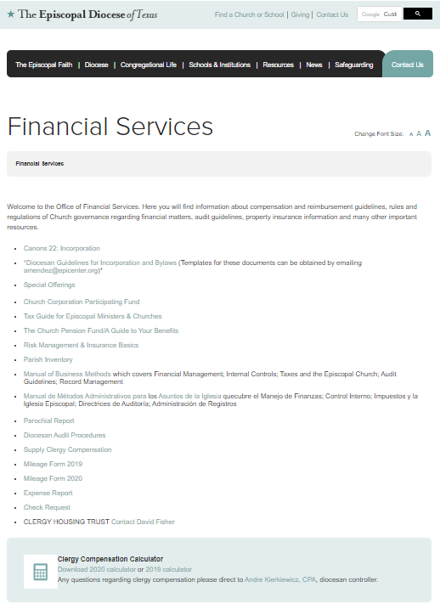
http://www.epicenter.org/diocese/the-office-of-financial-services/
Webpage:

