Slide 1
SAFEGUARDING GOD’S CHILDREN
Ministries of wellness & care
Notes:
After welcoming people, be sure to give trigger warning, an example of which is below.
****TRIGGER WARNING****Do Not Skip
This is a place and time for us to talk about our community and the work we do together to create environments that are safe for children, youth and adults. I will do my best to make this a safe place for all of you, and I ask the group attending to also agree to make this a safe place for everyone.
Conversations about child sexual abuse can bring up emotions that are distressing and may be difficult to manage in the moment. If this is the case, we want you to know that you are free to participate to the extent that you feel comfortable. We trust that you know how best to care for yourself.
Sometime people choose to share personal experience. This is not a requirement to participate or an expectation of the training. If you choose to share a relevant, personal experience, please know that you can count on respectful listening and confidentiality. Any personal story shared here is private and not for use in future trainings.

Slide 2
PRAYER FOR THE PROTECTION OF CHILDREN
Almighty God, heavenly Father, you have blessed us with the joy and care of children: Give us calm strength and patient wisdom as we bring them up, that we may teach them to love whatever is just and true and good, following the example of our Savior Jesus Christ.
Amen
Notes:
This prayer from BCP can be replaced with another prayer, reflection or quote that best suits your audience.

Slide 3
INTRODUCTIONS
Your Name
Community/Role
Why is this training important to your community?
Notes:
Introductions are a great way to help participants get comfortable interacting on zoom: Introductions can take up more time than you have planned, depending on the number of people joining the training. Remember to give clear instructions about what you want them to offer and the time they have in which to speak.
You can skip this step altogether if you are working with a group from the same location who probably already know each other.
An alternative is to have a quick icebreaker. Ask why this training is important to their community/ministry or consider a question such as “What good thing did you do for yourself today?”

Slide 4
WHY DO WE TRAIN?
What does this information mean to me?
How does this training impact my community?
Notes:
Encourage participants to “look again” at their communities with an eye to assessing how safeguarding policies are implemented, what they do well and how things could be improved.
Remind them that the heart of our work and ministry is relationship and that relationships with children can be a catalyst for growth or distorted for self-gratification.
Remind them Episcopal institutions reflect the baptismal promises to seek and serve Christ in all persons, loving our neighbor as ourselves, to strive for justice and peace among all people, and to respect the dignity of every human being.
Goal is to provide safe, nurturing environments for all children, which is one way we live into these promises.
Training and adherence to policies demonstrates accountability to parents and to the communities where we work and volunteer.

Slide 5
Introductions
This section focuses on understanding how child sexual abuse occurs in organizations where building relationships is key
Participants will be able to identify conditions that allow abuse to occur in organizations
Participants will identify boundaries appropriate for their roles

Slide 6
SOME STATISTICS
Notes:
We also train because we know reality of our culture. Child abuse is major health concern in our country and around the world.
Go over the statistics.
Focus on statistics on left. Name at least 3 things we can tell about a potential offender based on this information? Ask for responses before adding the following.
Someone who has gained the trust of the child
Someone who has gained the trust of the parent, guardian or organization
Someone with access to the child – may be considered a safe adult
Someone with opportunity to be alone with a child or to be unobservable
Now name at least 3 things that this doesn’t tell us about a potential offender. Ask them to respond – wait before prompting with some of the following:
Gender, age, religion, sexual orientation, race, socio-economic status, etc.
None of the characteristics we have mentioned, taken together or separately are any indication of whether someone is safe or not safe. The best tools we have at our disposal are an understanding of how an offender gains access to children, the ability to identify behaviors that an offender may engage in and awareness of our role in preventing abuse.

Slide 7
WHAT DOES AN OFFENDER NEED?
Notes:
What conditions must be present of an offender to offend against a child. Access, Privacy and Control
Access –How does an adult gain access to a child? Solicit possible answers from 3 people
Finds jobs or volunteer positions that involve working with children (watch for frequent job changes)
Initiates contact with children offers to spend time even when it isn’t requested like picking them up from school
Engages children online
Overextends themselves by volunteering to give up personal time to tutor, babysit or spend time with a child, especially if parents are over extended.
Ask: How do offenders gain access to children or youth in a virtual world?
2. Privacy – Offender will look for opportunity to be alone with children.
Offers to take them to the bathroom
Offers private lessons
Meets in private spaces or staying late on a job or premises where there are children.
Discourages adults from participating in or monitoring activities with children.
Communicates privately with children – text, phone, FB, Instagram, or other social networking sites.
Ask: What are limitations an adult should place on their engagement with a child in a physical environment? In a virtual environment.
3. Control – How an offender isolates a child, makes a child emotionally dependent, and secures their loyalty so they won’t tell.
Encourages child to break or stretch rules
Gives special gifts – in secret – without permission or against parents wishes
Treats children as if they were peers (uses inappropriate language or swears, tells off-color jokes, talks to kids about personal topics)
Threatens or intimidates child.

Slide 8
HEALTHY BOUNDARIES
How to create safe environments by establishing healthy boundaries:
Physical
Emotional
Behavioral
Notes:
Defining Boundaries is the process of determining what is acceptable and what is not.
Emotional Boundaries: Protect self- esteem and identity with right to make one’s own choices. To feel what one feels and not be shamed, dismissed or ridiculed. To not take responsibility for another’s feeling.
Physical Boundaries: Protect our bodies. Help us decide what are acceptable levels of physical closeness and with whom we are physically intimate.
Behavioral Boundaries: Protect our actions. What makes us sensitive to what might be hurtful to someone. Keeps us from actions that might be harmful to ourselves or other people.
Adults model behaviors that help children identify who are safe adults.
Healthy boundaries allow for expressing affection, communicating, and relationship- building in a way that is transparent and understood by both people
Possible breakout conversation: What happens your boundaries are not respected – what impact does that have on your sense of safety and on your relationships?

Slide 9
GROOMING
Dr. Monica Applewhite, Ph. D., Director of Confianza, LLC
Notes:
Ask for comments on what stood out for participants
“Grooming is the process of preparing a child or young person to experience relational sexual abuse without strong resistance or subsequent disclosure. It is a pattern of boundary violations intended to increase closeness, dependency, involvement and trust between the adult and the child he or she is targeting.” Monica Applewhite

Slide 10
BEHAVIORS THAT VIOLATE BOUNDARIES – Warning Signs
Any unwanted form of physical affection
Inappropriate or lengthy embraces
Kisses on the mouth
Holding children over 3 years old on the lap
Sharing personal information or asking them to share information with you.
Showing affection in isolated areas
Touching knees or legs, wrestling, or tickling children or youth
Playing pranks that are hurtful or scary
Being emotionally volatile with a child/youth
Any type of massage given by an adult to children or youth
Allowing a child/youth to break rules of parents or organization
Comments or compliments (spoken, written or electronic) about physique or body development
Giving money or gifts to individual children or youth
Putting demands on a child/youth for affection of attention
Inappropriate interaction on social media (See Social Media Policy)
Notes:
Some boundary violations are observable – Some are more subtle
Identify a physical boundary violation from the list above.
What do you think an offender gains by violating a child’s physical boundaries?
Desensitizes child and adults to greater physical interaction
Child and adults may begin to believe the greater physical interaction is harmless
Identify an emotional boundary violation from the list above.
What does an offender gain by violating a child’s emotional boundaries?
Make the child believe they are the most special person in their lives
Create an emotional dependence (from video: children will often be made to believe that the offender cares deeply for them and that they are very special. Plays part in controlling child’s emotional life and minimizing chances that offender will be caught.
Identify a behavioral boundary violation from the list above.
What does an offender gain by violating child’s behavioral boundaries?
In getting child to break rules, they gain control of narrative – “you will get in trouble if you tell”

Slide 11
SCENARIO #1
You are working in a school setting. You are aware that a teacher is inviting specific children to have private tutoring in her classroom after school. Others are praising her dedication, but you are uncomfortable with the situation.
What are some red flags that may be creating your discomfort?
What questions would you ask about the situation?
How would you respond?
Notes:
Review scenario and discuss answers.
Teachers often tutor or work with children on projects after class. Why is this a problem? What questions would you have?
Possible responses:
Is it in alignment with the school’s policies?
How are children selected for tutoring?
Who knows they are being tutored? Is the administration aware?
Are the parents aware and is there an agreement that the child needs tutoring?
Is there opportunity for casual monitoring exist?
This scenario is based on an actual situation. The teacher who invited children back into the classroom after school was sexually molesting the children. Many teachers voiced admiration for the teacher who was spending so much free time with children who needed extra help or attention. Some expressed concern about their own lack of extra effort, knowing that they needed that time after school to prepare for the next day. No one was familiar with the process of grooming.

Slide 12
Introductions
This section addresses the creation of safe spaces; how policies are the framework for observing and interrupting inappropriate interactions in diocesan organizations
Participants will identify potential opportunities for policy violations in their locations
Participants will demonstrate their understanding of appropriate interactions by applying the policies to specific scenarios
Notes:
Let people know that it’s not possible, in the time allotted for the training, to cover all sections of this policy in depth. Remind them they need to spend additional time with the policies to familiarize themselves with those sections we don’t cover in full.
For example; someone responsible for putting together a mission trip needs to know the requirements for travel and overnight trips.
Remind them that the Safeguarding Team is available to discuss any policy questions.

Slide 13
DEFINITIONS POLICY PAGES 5-8
Age Categories
Who is an adult?
Personnel
Not just employees
Terms, including
Gender identity terms
Activities, programs, etc.
Sexual abuse, neglect
Notes:
This section provides a common understanding of how specific definition & terms are used.
Policies require that adults supervise children and youth activities, which means we must define “adult” Go over definition.
Read definition of Personnel: Ask participants to find themselves on list.
Any surprises? (talk about key holders)
Suggest they read section for themselves later.
Terms aid understanding.
Mention that Gender is defined and discussed (e.g., cisgender and non-binary)
Roles are defined, including “Responsible Person.” (Discuss)
Activities are classified, like offsite, overnight, and travel, which affects level of supervision and monitoring required
Read the definition of abuse, page 7: Sexual abuse covers range of behaviors that may or may not involve physical contact. What are some examples of sexual abuse: Possible answers: inappropriate touching, exposure to child, anything done to sexually stimulate the adult

Slide 14
CREATING SAFE AND HEALTHY ENVIRONMENTS POLICY PAGES 9-13
Not conduct any one on one talks
Behavioral Standards for Personnel
Sexual Activity Between Children
Basic Needs
First Aid and Medications
Discrimination and Harassment
Bullying
Weapons and Violence
Alcohol
Notes:
Section describes how we create safe and healthy environments
Won’t cover every section. Up to participants to review, especially if leaders.
Everyone MUST understand Behavioral Standards
Spend some time on Behavioral Standards (including not being under the influence of alcohol, etc.)
Leaders need to review sections on basic needs and first aid and medications as they concern their programs
Policies aren’t focused only on preventing sexual abuse but on overall care of children
When properly addressed, all the above constitutes safe environment.

Slide 15
REFLECTION
What does safety look and feel like?
Notes:
Have participants reflect on their own childhoods and what made them feel safe.
Goal is to achieve that sense for children in our care.
Consider the vulnerability of children in their care
Why are some more vulnerable than others (minority in group, gender identity or sexual orientation, disability, family issues, socio-economic status)
What do they need to feel safe?

Slide 16
BEHAVIORAL STANDARDS FOR PERSONNEL
Not conduct any one on one talks
Do not engage in behavior that crosses emotional, physical, behavioral boundaries
Discuss expectations for developing private relationships
Do not use, possess, distribute, or be under the influence of alcohol or illegal drugs ...
Do not engage in sexual contact or become romantically involved with a child or youth
Do not discuss one’s own sexual activities
Do not sleep in the same bed unless the adult is an immediate family member
Do not use physical punishment
Do not use harsh language
Notes:
Read first paragraph on Page 9 of policies. We accept limitations so that our behaviors and interactions are defined, consistent, and identifiable as those that are healthy rather than harmful.
Read A.1 on page 9. What stands out? Some life situations create greater vulnerability.
Discuss: What message do we send to children when our behavior is consistent with the standards?
Let them know the behavior that is appropriate in THIS environment (v. at home, etc.)
Communicate what trusted adults look like and how they behave.
Discuss: What message do we send to children when our behavior is inconsistent with the standards?
Create confusion about how adults are supposed to act
Communicate that it’s okay to operate outside of boundaries

Slide 17
APPROPRIATE DISPLAYS OF AFFECTION
Personal are encouraged to offer displays of affection that respect physical, emotional, and behavioral boundaries, such as
High fives and fist bumps
Handholding with small children or during prayer
Brief touching of shoulders, hands, and arms
“Laying on of hands” under appropriate pastoral supervision
Brief hugs and arms around shoulders
Notes:
Have a participant read the section. Discuss some are all of questions below (as time permits)
What other ways do you have of showing affection to a child?
How do you show affection in a virtual setting? (Zoom class, tutoring, mentoring, etc.)
When is “appropriate affection not appropriate? Answer: When it isn’t wanted.
How do we know when a child does not want to be touched to show affection? Answer: may say something or show us in their body language (demonstrate)
Because of the power imbalance between children and adults and because children typically want to please, they may be reluctant to say no. It’s up to adults to be aware of what a child is communicating, whether by words, body language, reluctance, or resistance.

Slide 18
SEXUAL ACTIVITY BETWEEN CHILDREN
As much as 40% of children who are sexually abused are abused by older, more powerful children –D2L
Intervene immediately to stop behavior and report
Be attuned to power imbalance: older, larger children with younger, smaller children
Be aware of locations where sexual activity is most likely to take place (to be discussed under Monitoring and Supervision)
Be aware of situations in a child’s life that might increase the child’s vulnerability
Notes:
Curiosity about sexuality and their bodies is part of a child’s development
Characteristics of developmentally appropriate sexual behavior may include:
Occurs between children who have an ongoing mutual friendship
Occurs between children of similar size, age, social and emotional development
When adults set limits, children are able to follow the rules
Children may engage in harmful sexual behavior without understanding the impact on others.
Behaving sexually in a public place
A young child’s engaging in adult-like sexual contact with other children
Sexually harassing or intimidating behavior
Sexual interest in younger children or smaller children
Difficulty in stopping behavior when adults set limits
Whether the behavior is natural curiosity, intentionally harmful, or unintentionally harmful, the important 1st step is to interrupt the behavior without shame or harshness. Children need to know and respect boundaries about touching other children’s bodies.
Adults must report, either as a policy violation or as suspected abuse.
Offending against other children is not necessarily an indicator that a child will offend as an adult. https://www.ncjrs.gov/pdffiles1/ojjdp/227763.pdf
Stop It Now Tip Sheet - Age Appropriate Sexual Behavior
Stop It Now – Do Children Sexually Abuse Other Children
Center for Child Protection – Child Abuse & Neglect: The Impact of Trauma

Slide 19
WHAT IS BULLYING?
What is the difference between teasing and bullying?
What does bullying look like?
Who is vulnerable to being bullied?
Why is bullying so concerning?
Where does bullying often take place?
Notes:
Teasing may involve hurtful comments, taunting, or aggressive behavior, but what distinguishes bullying is that it is intentional, repeated and there is a power imbalance that could be age, size, or social standing. A child of smaller stature can be a bully, especially if they have the right skills, social power or position.
Bullying can be direct in nature such as physical acts of aggression and or verbal aggression. Can involve sexual abuse.
How else does bullying show up? Can be indirect such as isolating, rejecting, spreading rumors, or blackmailing
The reasons for being bullied most often reported include physical appearance, race/ethnicity, gender disability, religion and sexual orientation.
Adequate adult supervision is required in areas where bullying more likely to occurs.
Bullying most often occurs in the hallway or stairwell at school (425), inside the classroom (34%), the cafeteria (22%), outside on school grounds (19%), on the school bus (10%) and in the bathroom or locker (9%)
Students who bully others, are bullied, or witness bullying are more likely to report high levels of suicide-related behavior than students who report no involvement in bullying (Center for Disease Control, 2014).
Bullying should be reported within an organization. Contact Safeguarding Minister if you have questions.

Slide 20
Introductions
This section looks at warning signs that may help us become aware that sexual abuse has or is occurring
Participants will engage in conversation about the reasons children do not report abuse
Notes:
In addition to learning to observe interactions that violate a child’s boundaries, it is critical to learn to identify warning signs that may indicate a child has been or is currently in an abusive situation.
This sections includes resources that provide information to consider when warning signs are observed.
Participants will also discuss reasons why a child might not report abuse.

Slide 21
WARNING SIGNS FROM CHILDREN
Physical
Emotional
Behavioral
Notes:
Trauma is a subjective experience. Children interpret their unique experiences differently.
Responses to trauma are not in a child’s conscious control
Signs and symptoms of traumatic stress resulting from abuse may look different in each child and at different ages. Signs may emerge immediately, or they could emerge weeks, months or years later.
Important key is otherwise inexplicable change in a child’s behavior.
The following 3 slides discuss signs that are observable. When we see them, we should be able to say: I noticed this. Is everything okay? Would you like to talk about something? If child is not in trusting relationship to you, bring it to the attention of the Responsible Person or Program Supervisor.

Slide 22
PHYSICAL SIGNS
Frequent headaches, stomach aches, targeted pain
Sleep disturbances
Weight gain or weight loss
Pain in the genital area
Difficulty walking or sitting
Bladder or vaginal infections
Bruising if physical abuse is also involved
Pregnancy
Notes:
Physical signs of sexual abuse are rarer than signs of other physical abuse and more difficult to identify.
Give participants chance to review the list. Point to 1 or 2 of these signs. Ask if anyone has questions or comments.
Point out that all signs of abuse must be reported to Texas Dept. of Family Services, whether or not there are signs of sexual abuse. (More about this subject in a minute)

Slide 23
EMOTIONAL SIGNS
Unusual distress about being left by a parent
Mood swings. Irritability.
Flashbacks
Inability to concentrate
Suicidal thoughts or attempts
Depression
Notes:
Give participants a chance to review this list. Point to 1 or 2 of these signs. Ask if anyone has questions or comments.

Slide 24
BEHAVIORAL SIGNS
Withdrawal from friends or usual activities
Abrupt changes in behavior or school performance
Depression / anxiety
Age Inappropriate sexual knowledge
Rebellion or defiance
Inflicting self-harm/risky behavior
Sexual Victimization of other children
Notes:
Give participants aa chance to review this list. Point to 1 or 2 of these signs. Ask if anyone has questions or comments.

Slide 25
RESPONDING TO SIGNS OF ABUSE
1. Recognize the signs
2. Talk to the Child
Follow guidelines to create a non-threatening environment
Avoid judgement or blame – Assure the child they are not in trouble
Be aware of your tone
Talk to the child directly using the child’s own vocabulary
3. Report it
Know where to report
Be prepared to provide specific information
Ensure the child is in a safe place
Notes:
The information provided in this slide does not contain every recommendation about responding. You can find more information from: www.rainn.org/articles/if-you-suspect-child-being-harmed. Other resources include D2L, Stop It Now, and Childwelfare.gov to name a few
It is critical, in your role working with children, that you and your staff are prepared in advance to recognize signs, have a plan to engage a child if you suspect abuse, if the child/youth self-reports or gives verbal indication that something inappropriate may have, or be happening.
Ask participants why children may fail to report abuse
They may be afraid that they won’t be believed
They may be emotionally attached to their abuser
Young children may not have the language
May fear reprisal from their abuser
Knowing signs that may be indicators of sexual abuse is critical. As we have talked about, some signs are easy to overlook or explain away.

Slide 26
Notes:
Let participants know that there will be a check-in after this break and to consider what piece of the training has stood out for them and what they think will be most helpful in their work or ministry.

Slide 27
CHECK IN
What has especially stood out for you so far?
Notes:
Ask: What stood out? What information has been most helpful for them in their work or ministry
After Check-In:
First half of training focused on creating safe environments by knowing and modeling appropriate interactions and by understanding how and where offenders operate.
Second half will focus on monitoring and supervision to maintain safety of these environments and to respond appropriately when policy violations occur.

Slide 28
Section 4
In this section, participants will address supervision and monitoring of personnel, children and youth during on-site and off-site activities and events
Participants will discuss practices/procedures that allow supervising adults the opportunity to observe and interrupt behaviors/interactions that are inappropriate.
Participants will identity challenges to monitoring and supervision at their locations
Notes:
Let people know that it’s not possible, in the time allotted for the training, to cover all sections of this policy in depth. Remind them they need to spend additional time with the policies to familiarize themselves with those sections we don’t cover in full.
For example; someone responsible for putting together a mission trip needs to know the requirements for travel and overnight trips.
Remind them that the Safeguarding Team is available to discuss any policy questions.

Slide 29
MONITORING & SUPERVISION Pages 13 - 19
Personnel must monitor and supervise programs for children and youth so that inappropriate behaviors by adults, youth, and other children can be detected and stopped. The following rules apply whether or not the programs take place on property belonging to the diocese or organization.
Notes:
Ask participant to read the slide.
Monitoring is how we keep ourselves and each other accountable for keeping our environments safe.
As in the previous section, won’t t be able to cover policies in detail. Convey expectation that they will read policies, particularly the ones that most impact their ministry and roles.

Slide 30
MONITORING
Approval and tracking of programs
Posting of policies and contact information
Appoint Responsible Person
Know your ratios for staffing
Know special rules for off-site, overnight events, travel
Be prepared for unforeseen circumstances
Notes:
Requests for new activities must be submitted in writing to the head of the organization have written approval.
Policies must be posted where activities take place.
All activities must have an appointed Responsible Person.
Point out that schools or camps may follow accreditation and state licensing requirements. P. 14, G
Alert them to need to review special ratios for travel. P. 20, B
Ask what unforeseen circumstances they’ve encountered when supervising an event? Find themselves alone with one child? How did they respond in that situation.
Policies now address it: notify Responsible Person, Supervisor, and Head of organization as soon as possible. P. 14, E

Slide 31
ADEQUATE ADULT SUPERVISION
Two Adult Rule (at least 2 years older than participants)
Maintain line-of-site
Response to unplanned one-on-one meetings
For social media and online learning
For off-site events, overnight events, and travel
Be prepared for challenges of supervision during transitions, use of restrooms, and other activities
Notes:
Review: Who is considered an adult for the purposes of supervising children? Answer: An adult is one who is 18 years old and not in high school.
Must be two years older than the oldest participant
If have a high school program that is open to kids age 14 – 18 (or older if they are still in high school), can an 18 year supervise? No. The key is that it is open to all high school students.
What are the requirements if you have an off-site activity? - page 20, B. 1 & 3
Or driving? P. 21, D.1
Or travel? P 20, 1 & 2
Or overnight? P 22, E
(If you have time, ask participants to turn to pages in the policies to identify how different situations are addressed. Otherwise, alert them to particular rules re. age)

Slide 32
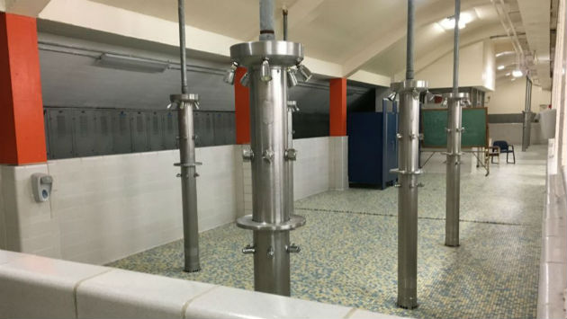
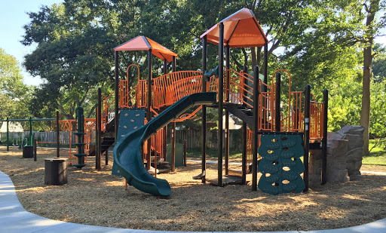
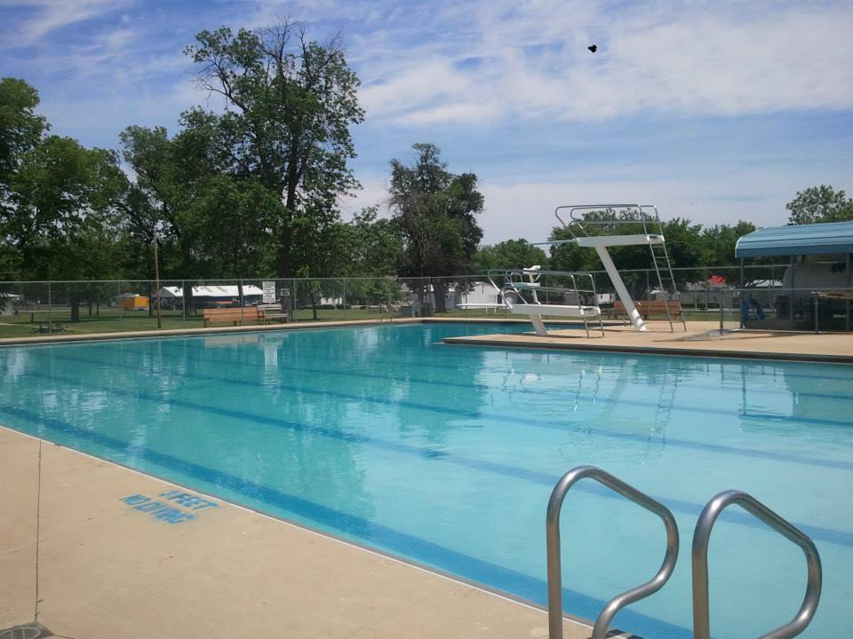
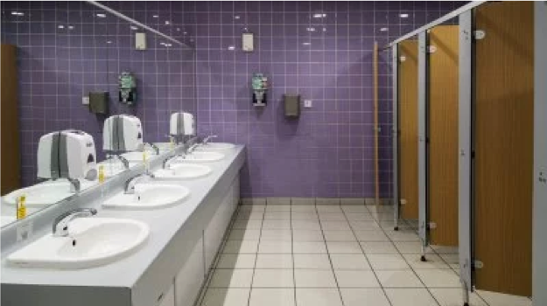
CHALLENGES TO SUPERVISION
Notes:
Visibility is critical to supervising activities. What it takes to maintain appropriate visibility changes depending on setting.
Ask participants to recall the slide on bullying. Where were the challenges to supervision?
How do you position yourself in a room to make sure you see all the room?
Hint: Not in the middle
Ask participants to describe challenges they have in maintaining visibility in their programs.
Ask participants to look at the pictures on the screen and identify the area where harmful behavior is most likely to take place and why?
Restrooms – less supervision, children can be partially clothed
Showers – same issues
Swimming pools – same issues and younger children and older children may be together
Playground – obstructions, tendency to talk with other teachers
Nap time – same issues, including lower lights, children under covers
Ask participants what happens if they find themselves in a less than optimal situation such as being alone with a child or if an adult cancels. How do you maintain visibility?
Possible answers: Open doors, roving monitor, move location

Slide 33
RESPONSIBLE PERSON
A Responsible Person (RP) is appointed by a program Supervisor to be on-site for the program/activity and to be accountable for compliance with the SGC policies.
Special Responsibilities include:
Administering medications to minors
Carrying documents needed for travel
Receiving reports of suspected abuse and boundary violations
Assigning rooms and occupants in the event of hotel stays (Recommended)
Notes:
New to policies in 2020. Important that Program Supervisors and Heads of Organizations know of the changes.
Must be an adult who is screened and trained under these policies

Slide 34
CERTIFICATION REQUIREMENTS POLICY PAGES 23-27
Personnel
Parent Volunteers
Youth Helpers
Training Only Agreement
Vendors and Non-Episcopal Partners
Tutors and Independent Instructors
Notes:
Think back to conversation about the 3 things an offender needs. Discuss how screening and training may help one of those things from happening.
Point to screening and training requirements.
Point to exceptions for parents – 6 x rule
Depending on whether participants include Program Supervisors, Heads of Organizations, etc., you may need to spend more or less time on this slide.
Ask if anyone if they use outside vendors in their programs and point to the options for screening and training
Explain the difference between “training only” certification and full certification – both involve screening and training
Ask if anyone uses tutors or hires independent instructors. – What are rules for screening and training
Encourage calling Safeguarding Office with questions.

Slide 35
This section addresses policy violations and appropriate intervention/response
Reporting suspected or known abuse
Participants will use the 3-part conversation to address policy violations
Participants will discuss reasons why adults don’t report
Notes:
Identify – Understand what behaviors are inappropriate in the context our organizations. Know the warning signs.
Intervene. - Know when and how to stop behaviors that are inappropriate.
Report. - Reporting internally insures that all appropriate people in an organization are aware of any situation that arises. Reporting to appropriate authorities allows for appropriate investigation.
These are the are most effective prevention tools at our disposal.

Slide 36
RESPONDING TO POLICY VIOLATIONS
Responding to a boundary violation
Interrupt behavior
Three-part conversation
Reporting
Personnel must report any behaviors they observe that are inconsistent with these Policies for the Protection of Children and Youth.
The head of the organization who receives a report of inappropriate behavior or a policy violation shall immediately report the same to the Safeguarding Minister or Canon to the Ordinary.
Notes:
Not all boundary violations and policy violations result in suspecting abuse. Must still be reported to an appropriate person.
Contact information must be posted where activities for youth and children take place, along with policies.
Ask participants to name some of the boundary violations they may see in their programs.
People to whom you may report – RP, Supervisor, a Warden, Head of the organization. Tell participants to read reporting section of policy for themselves. Head must know so that the violations can be addressed.
Must let Head know of violation unless Head is object of reported violation, in which case may bypass Head and report directly to SG Minister or Canon to the Ordinary.
Reports should always be objective, without supposition or speculation.
The following slides talks about interrupting behavior that is inappropriate and offering a teaching moment.

Slide 37
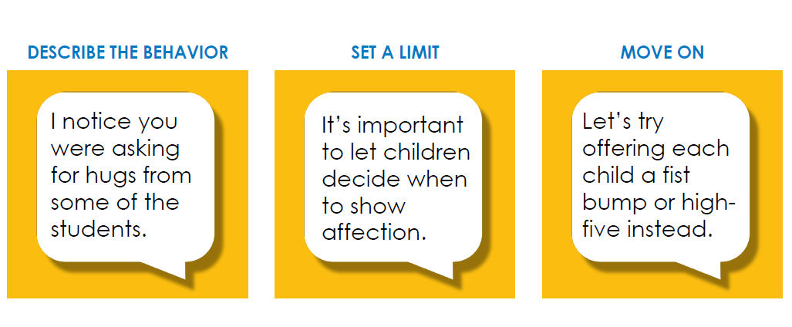
THREE PART CONVERSATION
How to respond to boundary violations and suspected abuse.
Notes:
Always interrupt behavior when it is happening.
Follow-up conversation is appropriate when the boundary violation that doesn’t rise to the level of suspected abuse--an opportunity to train in the moment. DON’T WAIT UNTIL THE NEXT TIME
Be specific about you observe without judgement or blame
Set a limit by making sure that the individual is aware of the specific policy they were violating.
Third step makes clear what is expected in future.
Refer to the 1st scenario. What would 3 step conversation have involved? What if boundary violation had been repeated?

Slide 38
SCENARIO #2
You are chaperoning a youth ministry event. A college-age volunteer sits with a high school student on the bus to the event. You see them talking and spending time together during the day. On the way home, the student lays her head on the volunteer’s lap. How do you respond?
Notes:
Break into small groups if appropriate to discuss the scenario.
What policies address this scenario?
Showing favoritism- spending time exclusively with one child
Having a child over the age of 3 in your lap
Does it matter what sex/gender the youth and chaperone are? (No)
How do you address this situation using the 3-part conversation?

Slide 39
REPORTING SUSPECTED ABUSE OR NEGLECT POLICY PAGE 28
Anyone who has reason to suspect that abuse or neglect of a child or youth has taken place is required to contact the police or the Texas Department of Family Protective Services (1-800-252-5400), or online at Texas Abuse Hotline
Reporting within a facility or organization
Reporting to the Safeguarding Minister or Canon to the Ordinary
Notes:
In Texas ( not true of all states), we are all mandated reporters. If we suspect abuse of a child, must report that abuse to civil authorities. Reports to civil authorities may be made anonymously.
Reporting should offer objective information. What you observed or what you were told, identifying information about the child. Sample reporting form is on SG webpage but isn’t required.
Anyone who has reason to suspect child abuse of any kind (not just sexual) should make a report even if not certain . For guidance as to what is cause for reasonable suspicion, see the Child Protective Services Guide provided by childwelfare.gov.
Know signs that suggest abuse: welts on the back of the legs v. bruising on knees or elbows, bruising that is in outline of hand, teeth marks, etc.
For more information about detecting signs of trauma see recorded webinar at:
https://centerforchildprotection.org/services/education-services/
As with boundary or policy violations, must also report to the appropriate person(s) in your organization. Do not need to report to anyone who is the subject of the complaint.
If head of organization or any diocesan employee, report directly to the Safeguarding Minister or Canon to the Ordinary.
Point participants to the page with names and contact information.

Slide 40
What are some reasons adults fail to report observed violations of policy?
What are some reasons adults fail to report suspicions of abuse or neglect?
Notes:
Why would we fail to report observed violations of policy?
Might make excuses for someone’s behavior, especially if we think the person’s motives for behavior were innocent
Don’t like conflict
May not know the policies well or understand the reason for standards of behavior
Someone we know and trust might be involved.
Why would we fail to report suspicions of abuse or neglect based on observation or report?
Might not be certain and don’t want to create problems.
Might not think it’s our responsibility.
Difficult to imagine someone hurting a child, so we may dismiss what we saw or heard.
Might not believe what a child is reporting

Slide 41
What observations or impression of the material would you like to share?
What does your program do well?
Based on what you have heard today, what might you do differently?

Slide 42
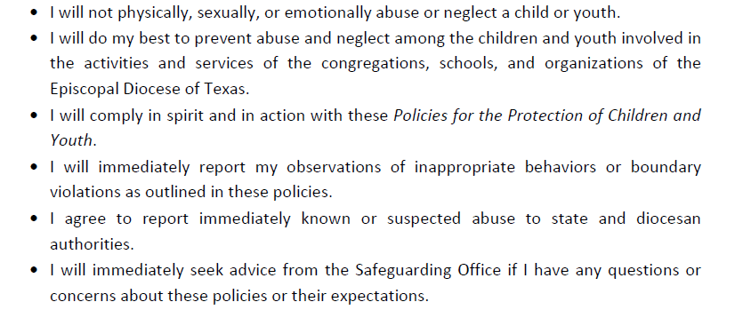
CODE OF CONDUCT
Following the prompt in the chat, please type your full name.
Notes:
Ask participants to read the code of conduct out loud, together.
Pass around the sign-out sheet, if in person training. Can have people put their name in chat box to indicate agreement if a Zoom training.
Final questions – Prayer at the end if desired.

