Slide 1


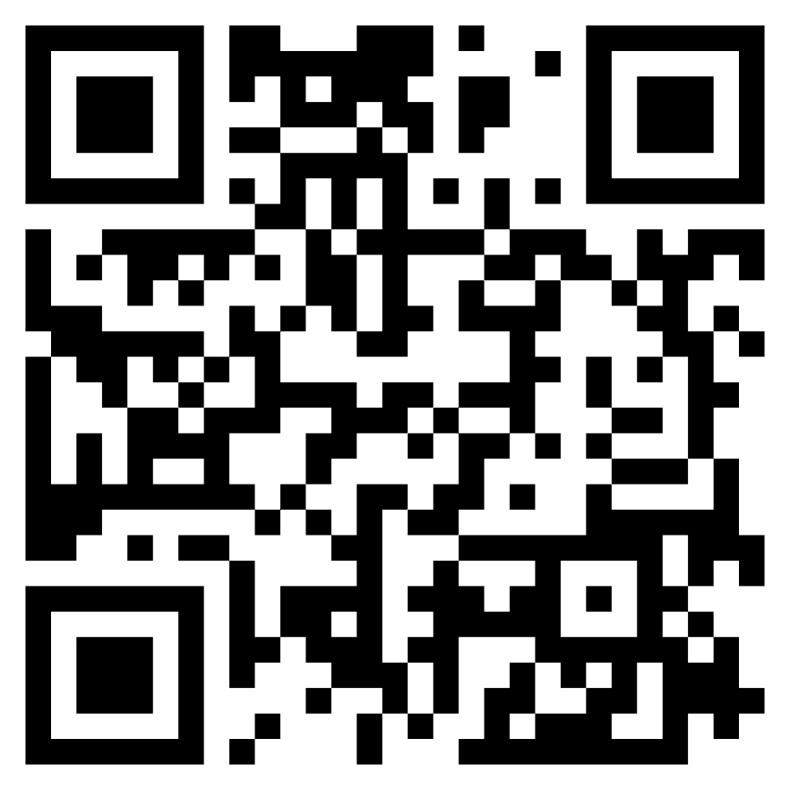
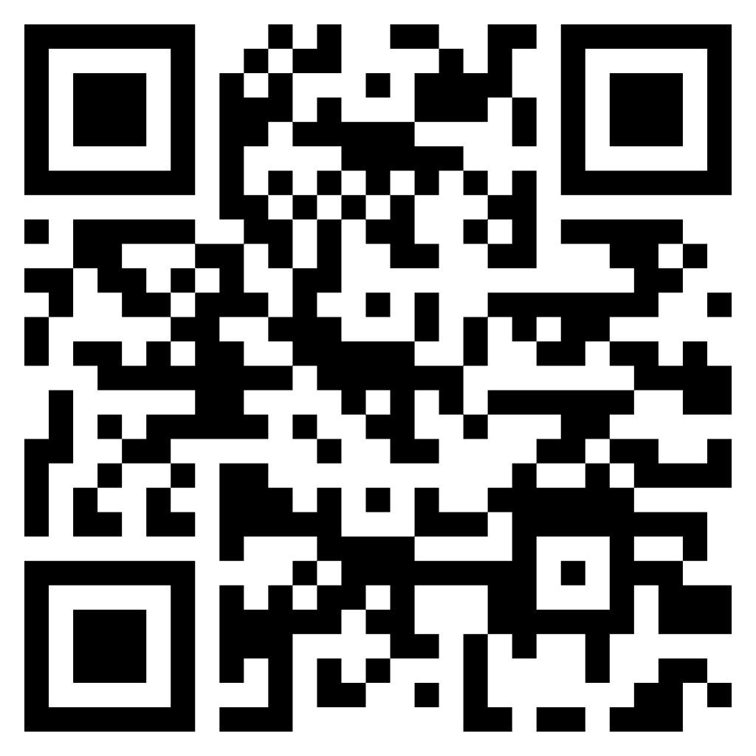
Brotherhood of St. Andrew Texas Assembly
20th Annual Charity Golf Tournament
Tuesday, May 12, 2026
"A Touch of Sanctuary"
Cypresswood Golf Club • Spring, TX
About the Tournament
Event Schedule
Registration
Proceeds from this event help fund the Brotherhood Annual Charitable Giving Program:
Events for At-Risk Boys
Academic Scholarships
Veterans Support Organizations
Homeless Ministries
10:00 AM Registration & Warm Up
Individual Golfer: $125
10:00 AM Silent Auction Begins
11:00 AM Driving Range Opens
Team of 4 Golfers: $500
11:00 AM Lunch Begins
Limited Number of Free Veterans Spots – Contact Randy Redd (below)
12:00 PM Shotgun Start
Register Online:
After the Event
www.brothersandrewtexas.org/registration
Sponsorship Opportunities
BBQ Meal & Awards Ceremony
Title Sponsor Contact for pricing
Door Prizes Drawing (must be present)
Register by Mail. Literature and Brochures
Brotherhood of St Andrew c/o Patrick Parham PO Box 12012 Spring, TX 77391
https://brothersandrewtexas.org/resources/
Hole Sponsor $300 per hole
Silent Auction Closes
BBQ Sponsor $500 – 4 available
Tournament Format
Beverage Cart $500 – 2 available
Scramble 4-Man Best Ball
For Further Information Contact: Randy Redd
Sponsor a Veteran $100 each
Prizes: 1st/2nd/3rd Place • Hole-in-One • Lowest Clergy • Longest Drive • Closest to Pin
ranredd@gmail.com
More information: www.brothersandrewtexas.org | The Brotherhood of St. Andrew has a mission to bring men and boys to Christ through Prayer, Study, and Service

